Slide 1
RDK II Analysis

Slide 2
RDK II Analysis
EP channel
Photon channels
Results

Slide 3
EP channel
Electron
Highest peak within the first 36μs
E_{e} = height of electron peak
t_{e} = time of the highest point in the electron peak
Proton
Highest peak between 1.2μs and 41μs after the t_{e}
E_{p} = height of proton peak
t_{p} = time of the highest point in the proton peak
Correct for signal drift

Slide 4
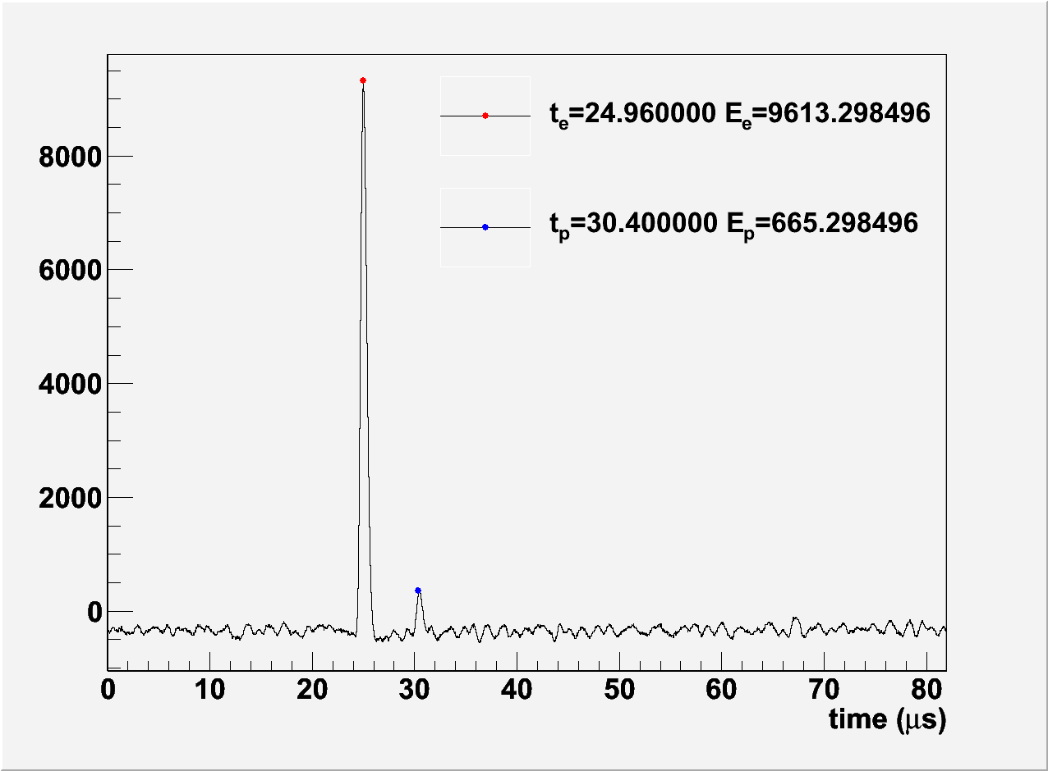
EP channel

Slide 5
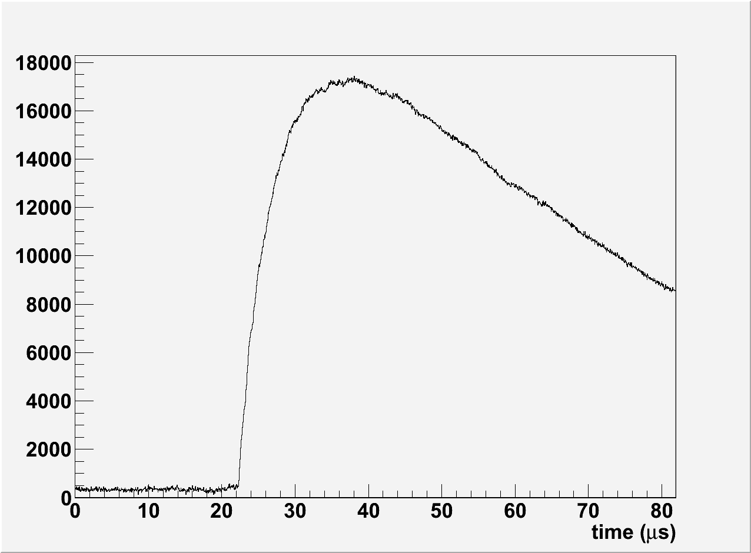
Photon channels

Slide 6
Photon channels
Fit function
A+Be^{-C(x-T)}(1-e^{-D(x-T)})
A = signal drift
B = intensity
C = fall time of the signal
D = rise time of the signal
E = height of the maximum of the signal above A

Slide 7
Photon channels
“A” algorithm
Calculate σ² for the regions between 0 and x in 5.12μs steps
If σ_{x+ 5.12μs} is more than 10% greater than σ_{x}
The range from 0 to x is flat
A = avg. signal strength from 0 to x

Slide 8
Photon channels
“T” algorithm
Signal strength
Weak: max-min<threshold=1400
Strong: max-min>1.5 threshold=2100
Normal: everything else
Trace signal from maximum to the start
Weak: threshold = A
Normal: threshold = A+σ_{flat}
Strong: threshold = A+2σ_{flat}
Trace backwards until the signal drops below threshold for 80ns and no more than 80 of the next 120ns are above threshold

Slide 9
Photon channels
Fit algorithm
On the region from T to end of signal
Linear regression
f = A+Bz
z = e^{-C(x-T)}(1-e^{-D(x-T)})
A, C and D are fixed

Slide 10
Photon channels
Fit algorithm
Non-linear regression
f = A+Be^{-C(x-T)}(1-e^{-D(x-T)})
A and B are fixed

Slide 11
Photon channels
Fit algorithm
Linear and non-linear regressions done simultaneously
Apply the changes of C and D as determined by non-linear regression
Recalculate the regressions
If the change in χ² is greater than 0.1% then repeat
Maximum of 100 repetitions

Slide 12
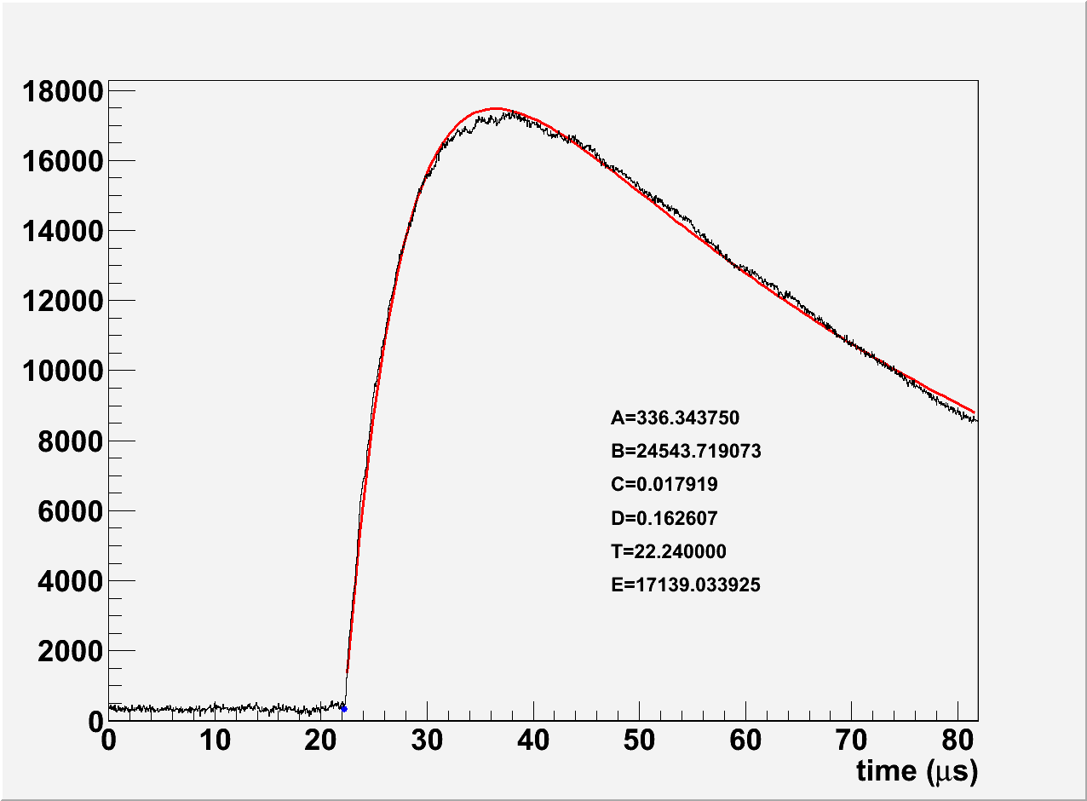
Photon channels

Slide 13
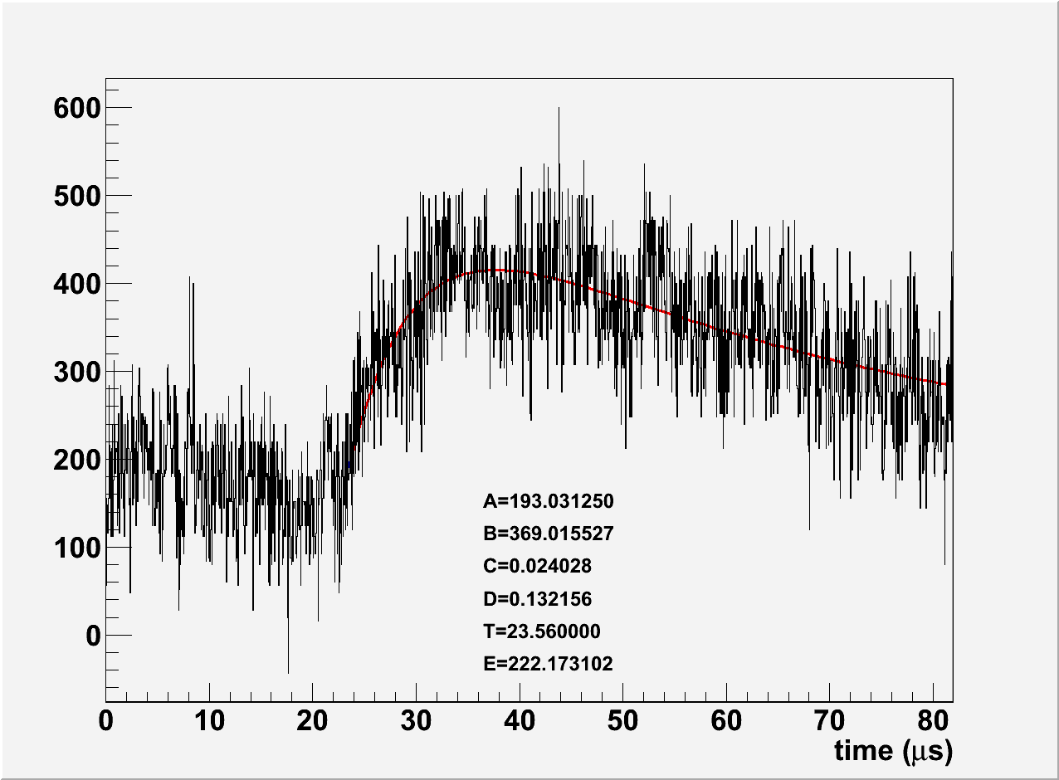
Photon channels

Slide 14
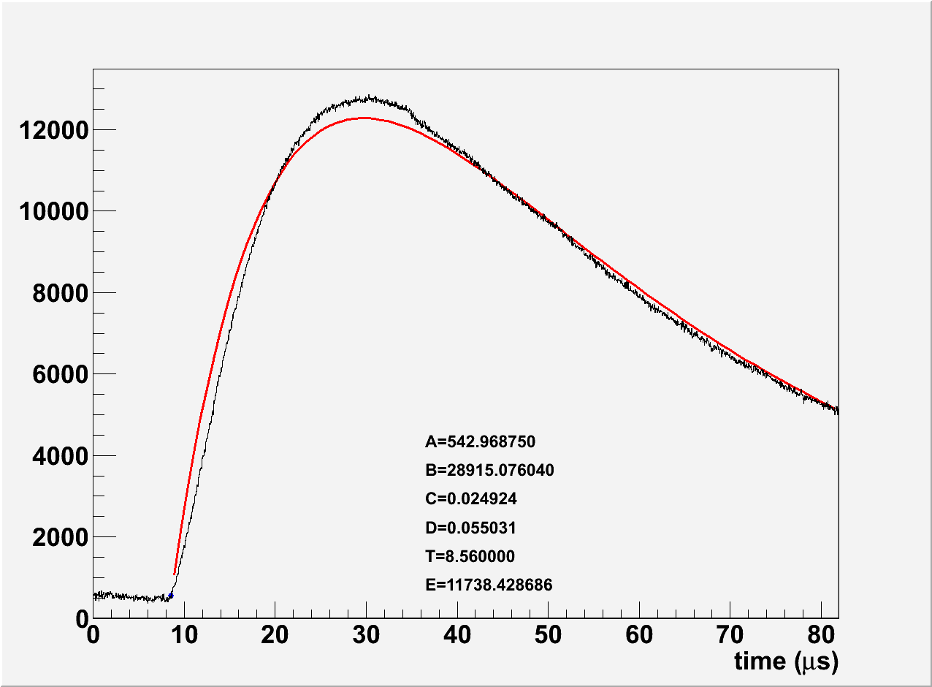
Photon channels

Slide 15
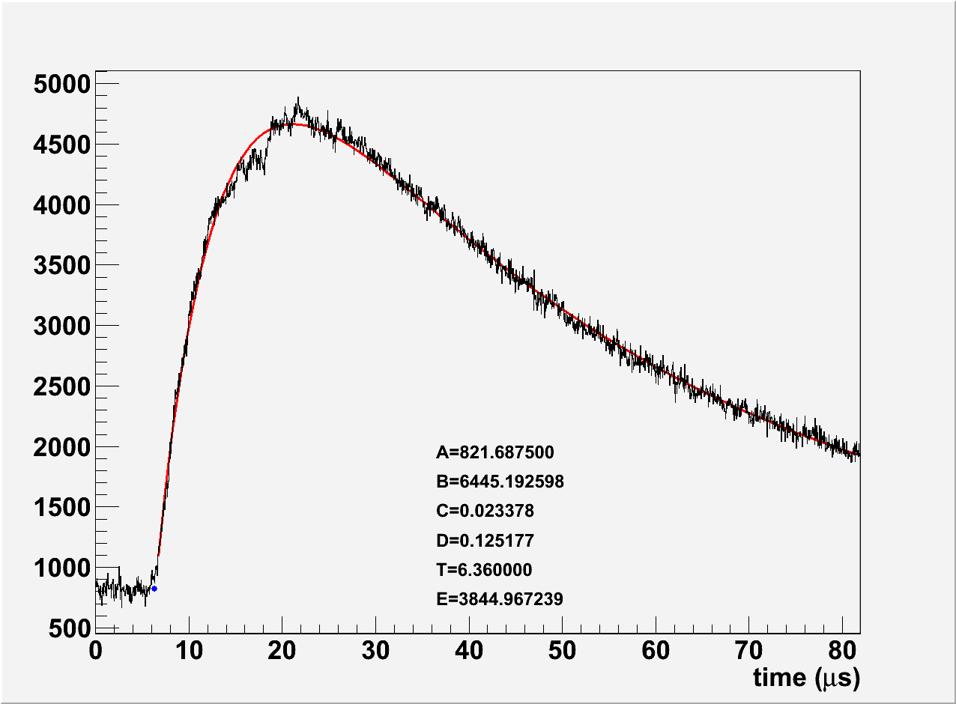
Photon channels

Slide 16
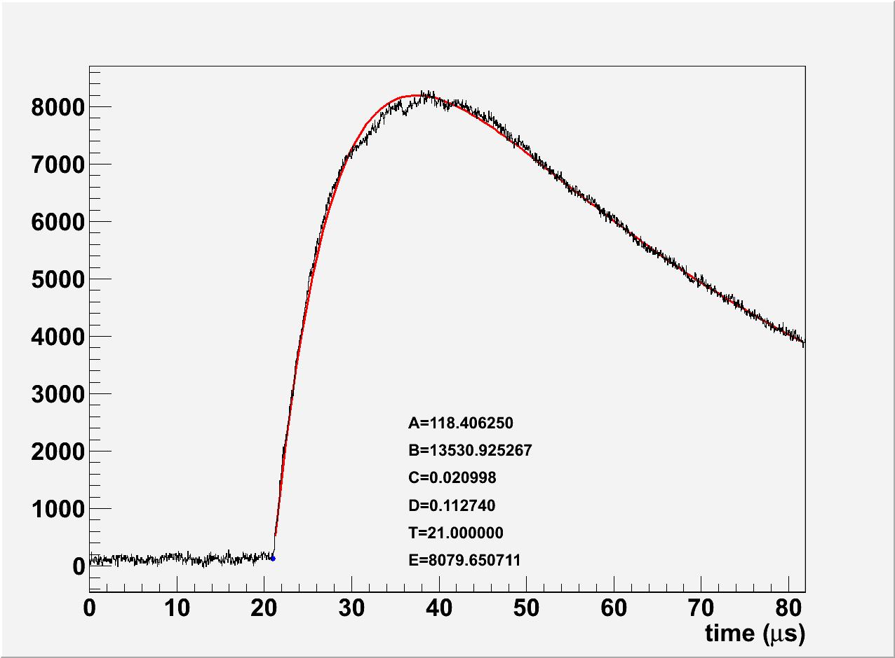
Photon channels

Slide 17
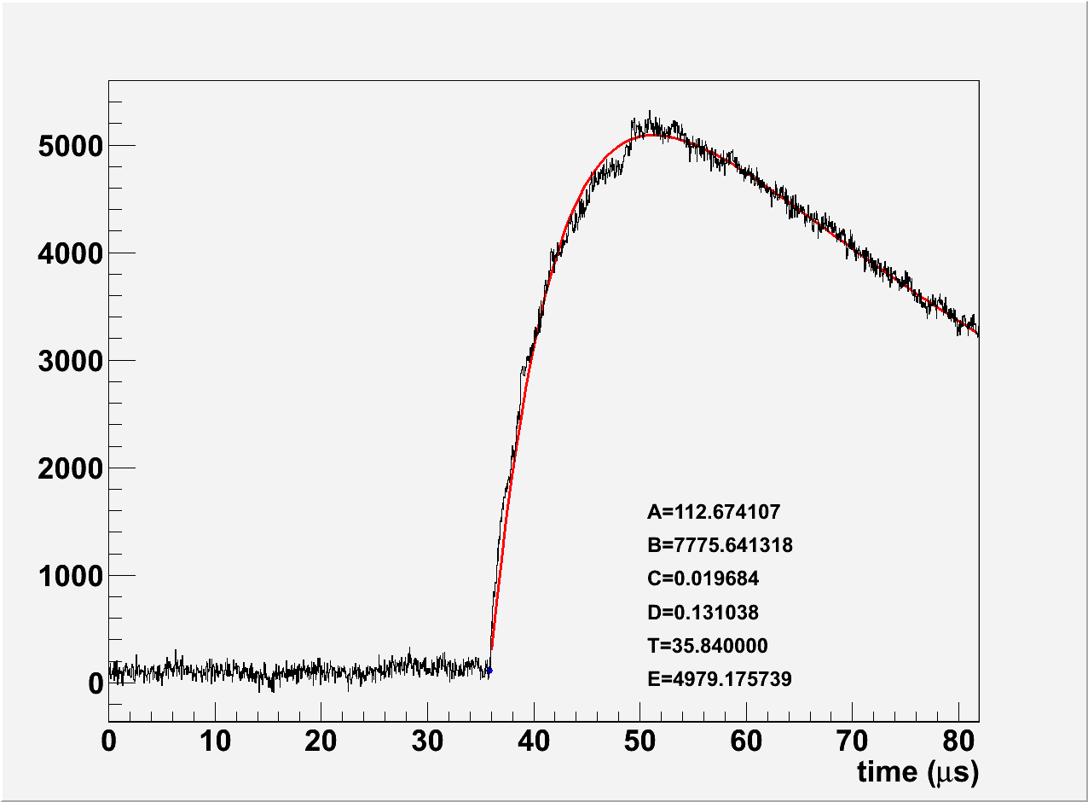
Photon channels

Slide 18
Results
From runs 104-106 and 108
All at 1400V mirror

Slide 19
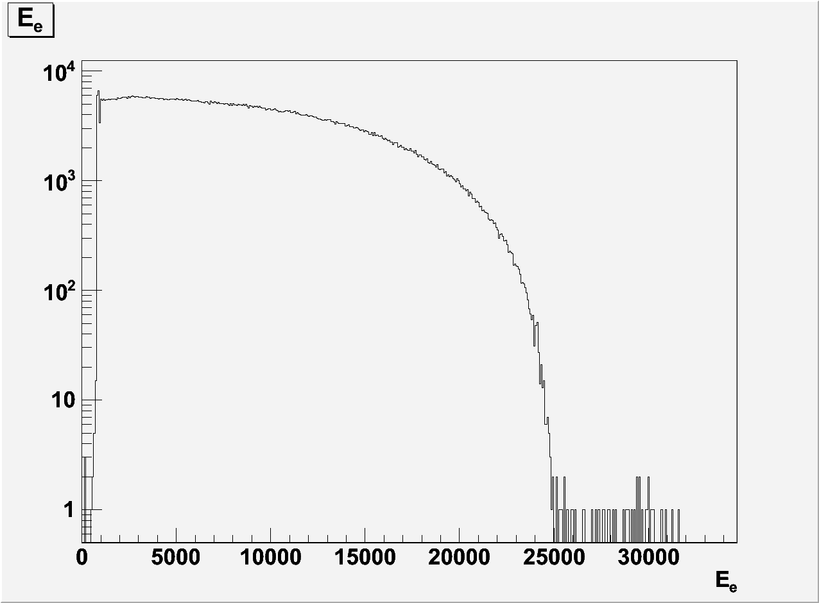
Results Electron energy

Slide 20
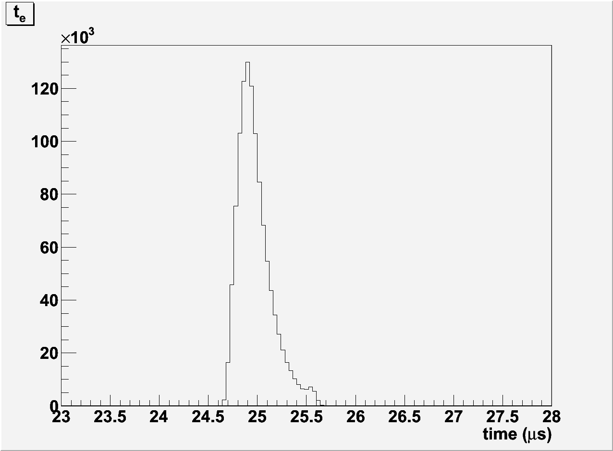
Results Electron time of flight

Slide 21
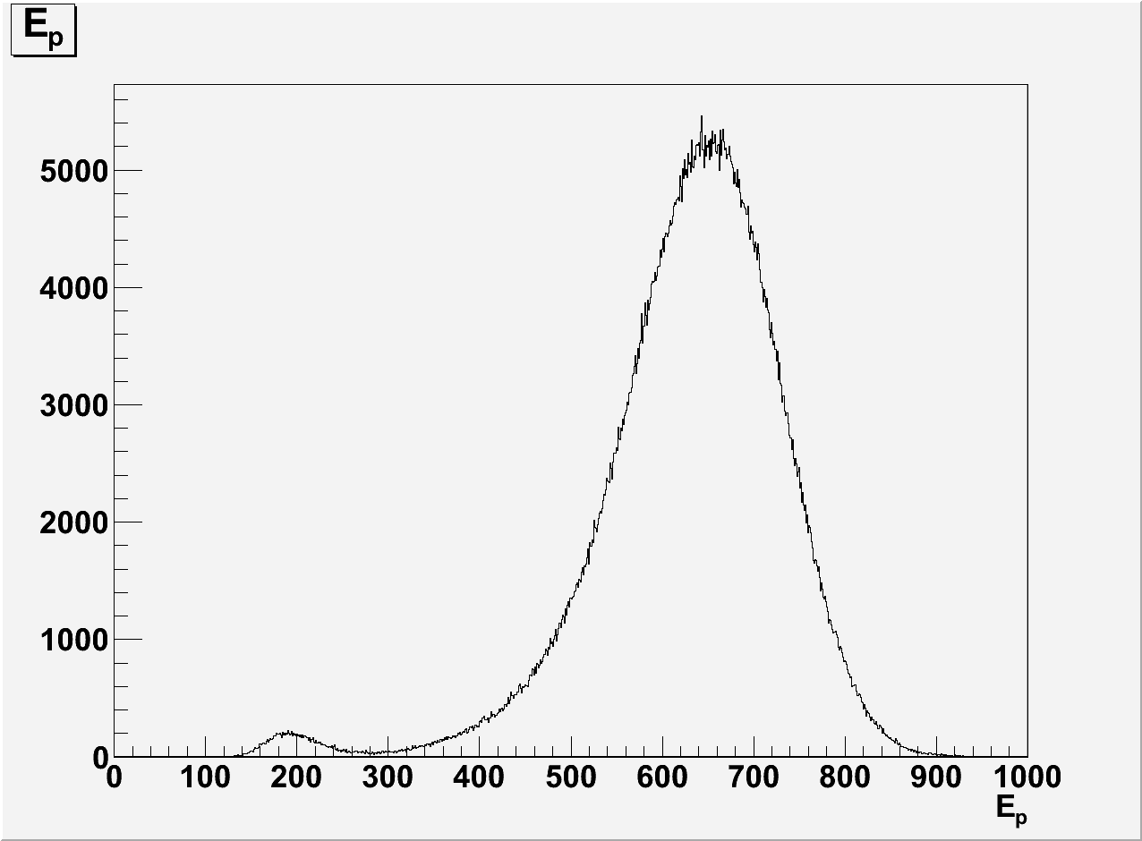
Results Proton energy

Slide 22
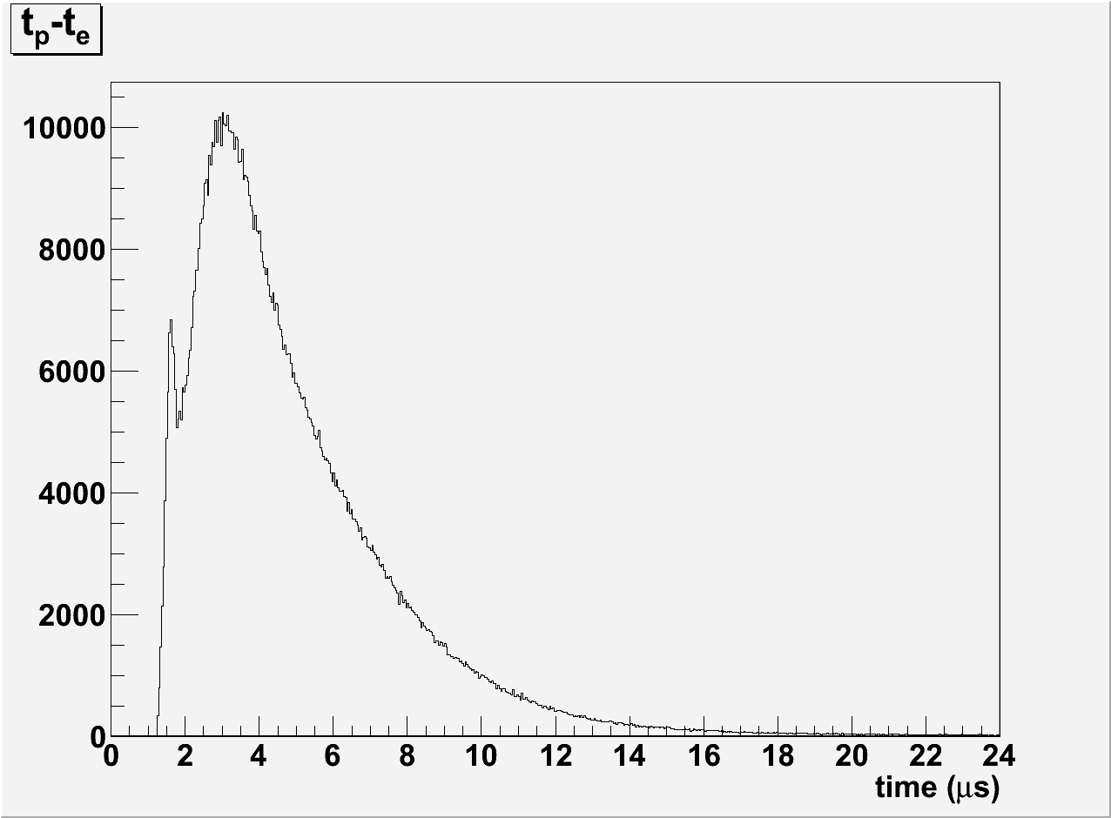
Results Proton time of flight

Slide 23
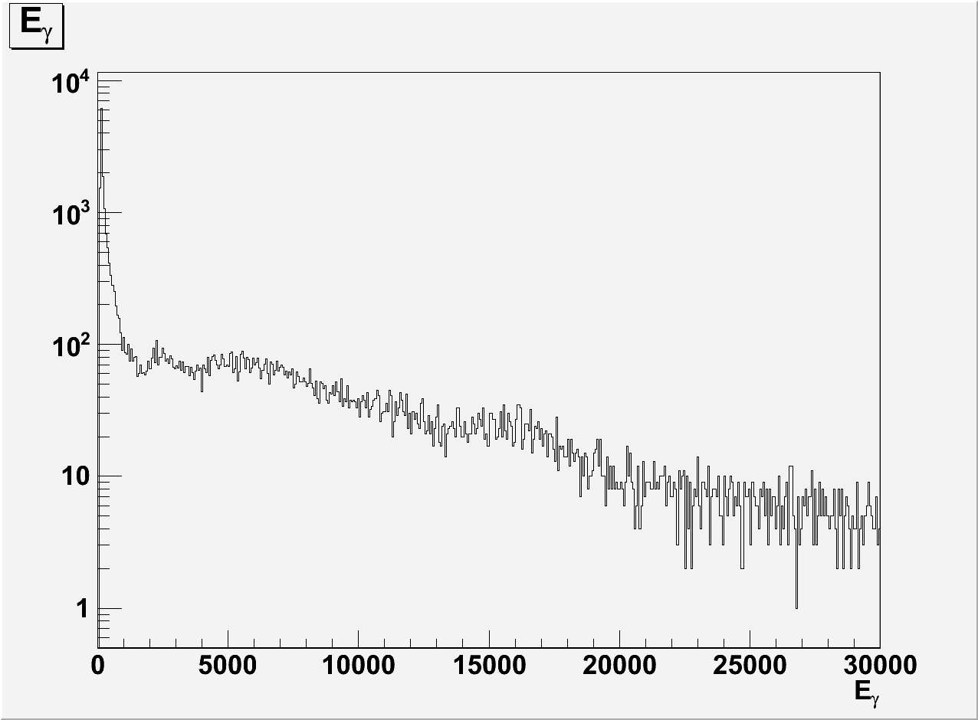
Results Photon energy – full range

Slide 24
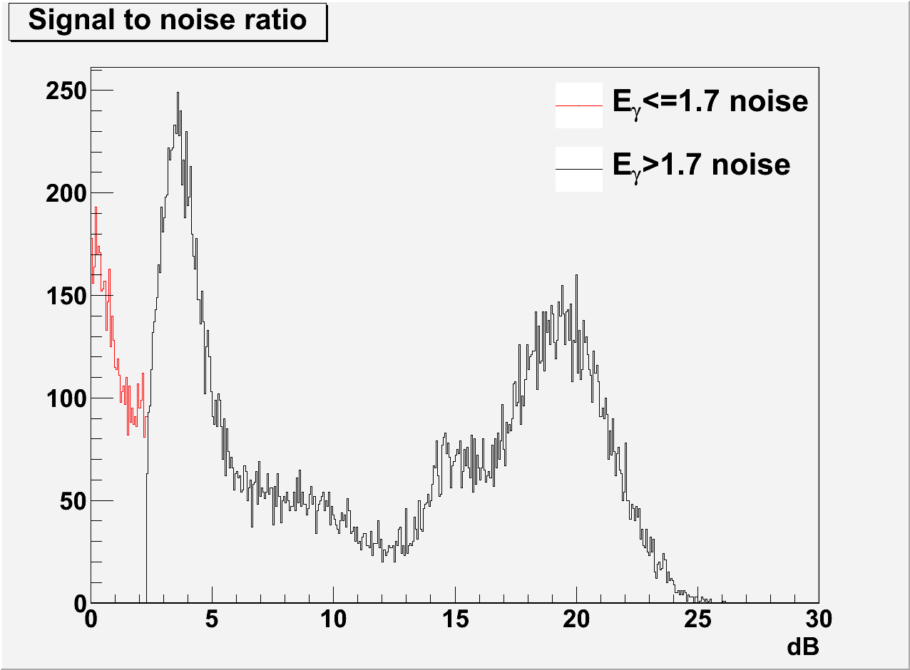
Results Signal to noise ratio on γ channels

Slide 25
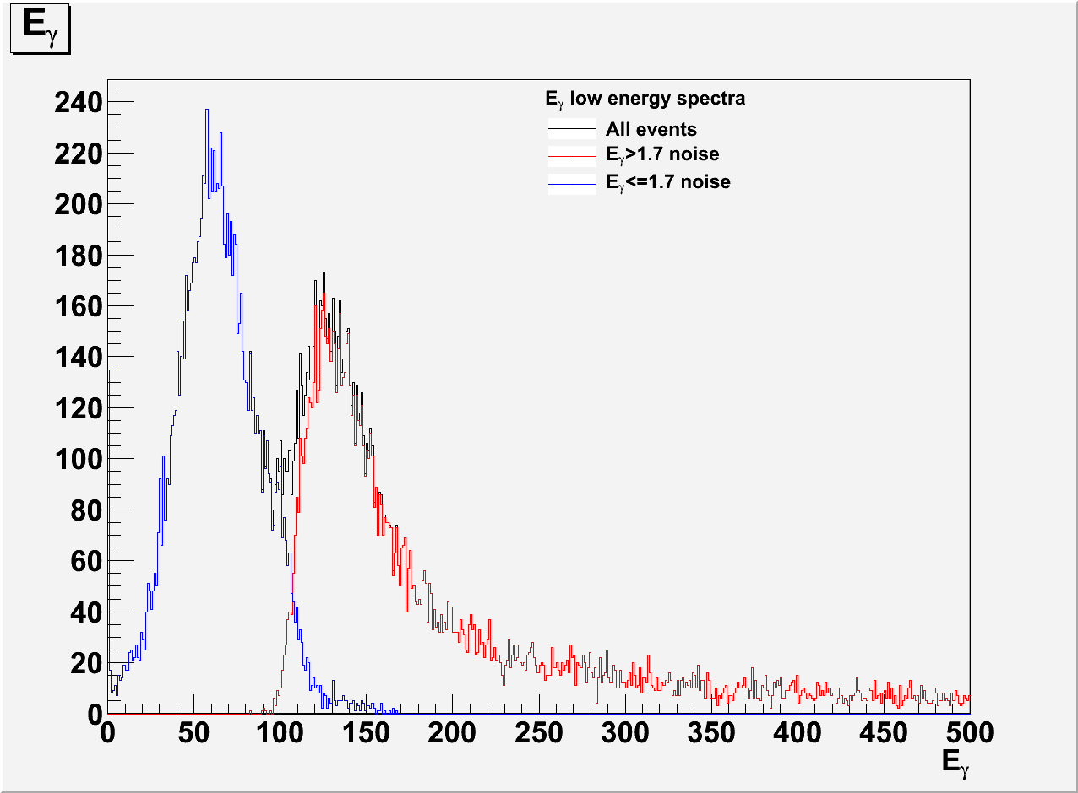
Results Photon energy – low energy

Slide 26
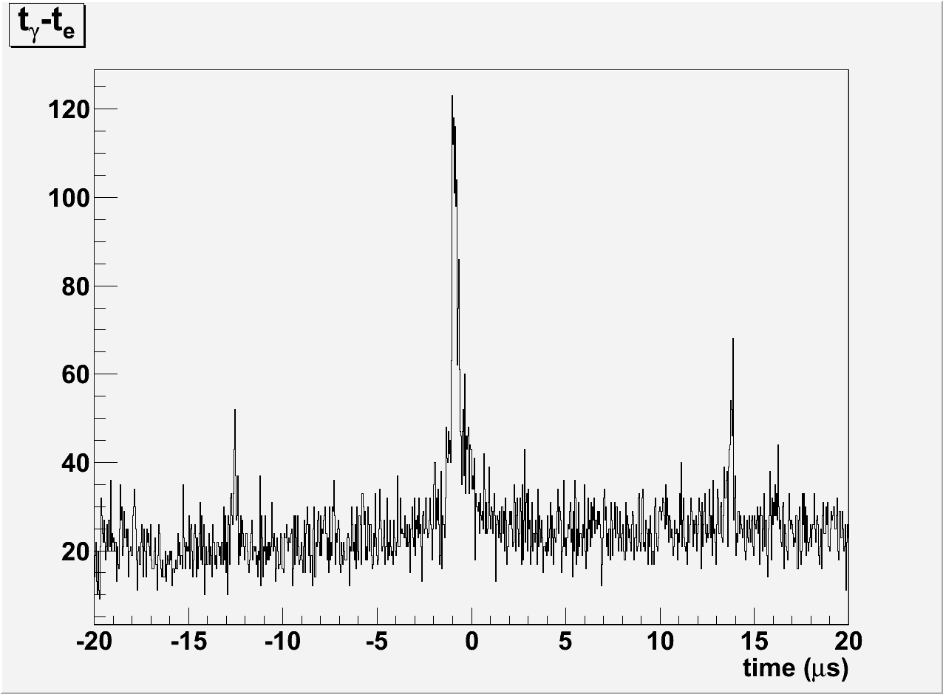
Results Photon time of flight

Slide 27
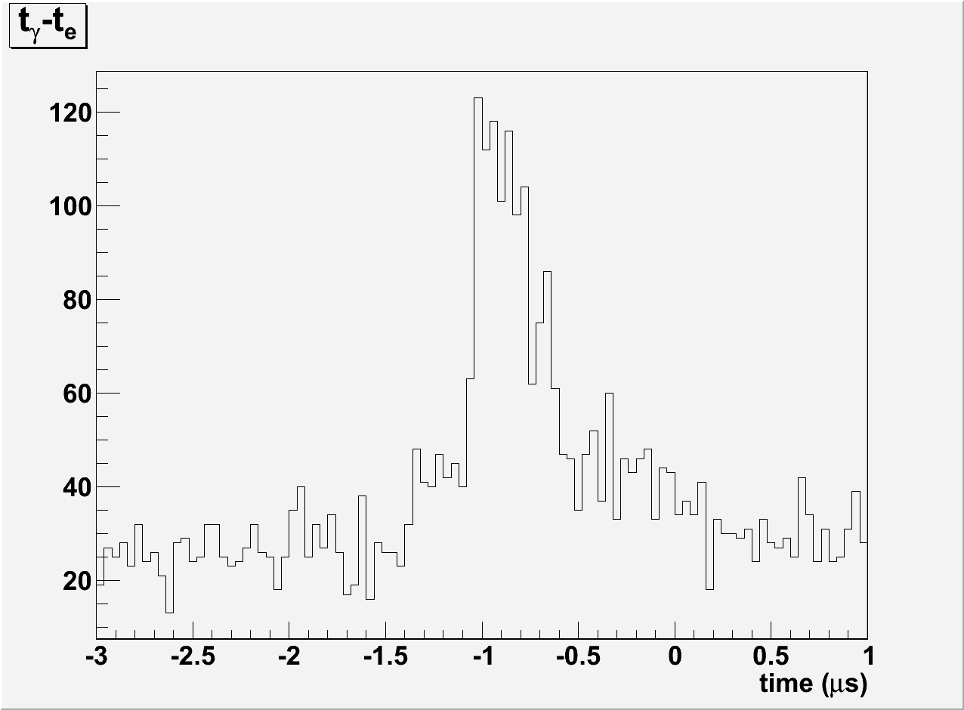
Results Photon time of flight close-up

Slide 28
Results Some actual numbers
My analysis – without background corrections
Jeff’s analysis – with background corrections

